Slide 1
UKMI – Practice Development Seminar
Workshop - How to start in research / write a poster and get it published
Dr Andy Fox
Consultant Pharmacist Medicines Safety
Deputy Chief Pharmacist

Slide 2
Starting Out in Research – Learning Objectives
Notes:
Look at the beautiful tree, lets put it into perspective it represents a complex organism with may boughs and branches and twigs and leaves all connected.

Slide 3
Starting Out in Research – Learning Objectives
Notes:
So I want to bring research closer to you more easy to grasp and view and comprehend. This also represents the first key message.

Slide 6
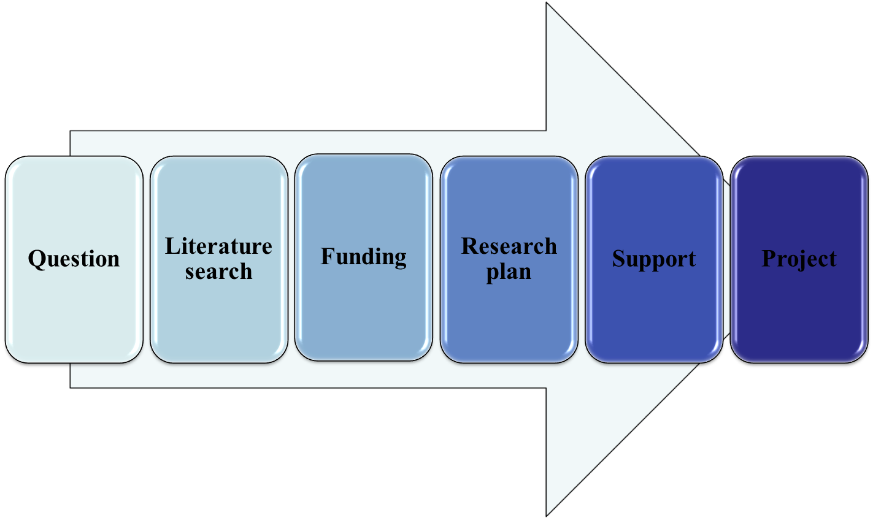
Research – Some of the stages/barriers
Ethics/Permissions
Training
Patient Public Involvement
Dissemination
Audit
Service Evaluation
Quality improvement
A Question
Notes:
There are lots of stages to undertaking research and all this can seem very foreboding and off-putting. It is very easy to go off with an amazing idea and end up being put off because we as pharmacists want to create robust evidence- so the double blind placebo controlled trials that you love to find when doing a search in answer to a question is not achievable to the early researcher.
Start with audits or service evaluations or QI projects – all of these will improve the research skills

Slide 8
The Question
Do medicines information pharmacists like cake?

Slide 9
A good research question PICOT/FINER
Clear – Focused – Concise – Complex - Arguable
Population
Intervention
Comparison
Outcome
Timeframe
Feasible
Interesting
Novel
Ethical
Relevant
What
How
Why
Notes:
Infection is common
One-third of hospital inpatients are on an antibiotic
Infection is serious
Around one in five patients admitted with pneumonia will die in hospital
Infection is complex
Treatment must be started quickly, often before we know what bacteria are causing the infection and whether they are resistant to standard antibiotics
Patients with infections caused by resistant bacteria stay in hospital for 5 days longer and are 3 times more likely to die
Infection experts are few and far between
If you have cancer, you will be cared for by an oncologist; if you have infection, you will be cared for by a general physician
Information to guide treatment decisions for patients with infection is held on multiple electronic systems
Find the patients with infection most likely to benefit from expert input
Help the experts to access key information quickly to make safe and informed decisions
Monitor any impact on antibiotic prescribing, resistance and patient outcomes

Slide 10
The Question
Do medicines information pharmacists like cake?
How does the quantity of cake consumed by UK medicines information pharmacists compare with the number of enquiries answered on each day of the week?
Now it is your turn – Write some questions about a MI research/service improvement /QI

Slide 11
How do I decide what to do?

Slide 12
How do I decide what to do?
Have you ever wondered:
Why do all the callers keep asking…..?
Why have I seen two patients this week/month with….?
I wish I didn’t have to ….. every time
How did that happen?

Slide 13
How do I decide what to do?
Previous work
What interests you
Current/topical
Funding body
Colleague/collaborators
Notes:
Infection is common
One-third of hospital inpatients are on an antibiotic
Infection is serious
Around one in five patients admitted with pneumonia will die in hospital
Infection is complex
Treatment must be started quickly, often before we know what bacteria are causing the infection and whether they are resistant to standard antibiotics
Patients with infections caused by resistant bacteria stay in hospital for 5 days longer and are 3 times more likely to die
Infection experts are few and far between
If you have cancer, you will be cared for by an oncologist; if you have infection, you will be cared for by a general physician
Information to guide treatment decisions for patients with infection is held on multiple electronic systems
Find the patients with infection most likely to benefit from expert input
Help the experts to access key information quickly to make safe and informed decisions
Monitor any impact on antibiotic prescribing, resistance and patient outcomes

Slide 14
Now it is your turn –
Write some questions about a MI research/service improvement /QI

Slide 15
Dissemination - Poster
What is the purpose?
Who will be looking at it?
What will the audience be looking for?
Where will it be displayed
Check conference guidelines
Check conference guidelines (again)
Notes:
Infection is common
One-third of hospital inpatients are on an antibiotic
Infection is serious
Around one in five patients admitted with pneumonia will die in hospital
Infection is complex
Treatment must be started quickly, often before we know what bacteria are causing the infection and whether they are resistant to standard antibiotics
Patients with infections caused by resistant bacteria stay in hospital for 5 days longer and are 3 times more likely to die
Infection experts are few and far between
If you have cancer, you will be cared for by an oncologist; if you have infection, you will be cared for by a general physician
Information to guide treatment decisions for patients with infection is held on multiple electronic systems
Find the patients with infection most likely to benefit from expert input
Help the experts to access key information quickly to make safe and informed decisions
Monitor any impact on antibiotic prescribing, resistance and patient outcomes

Slide 16
Acknowledgements
Emily Smith – Pharmacy Research Fellow emily.smith@uhs.nhs.uk
UKMI

Slide 17
Resources
Is it research
http://www.hra-decisiontools.org.uk/research/
Grant Writing!
https://www.aresearchguide.com/write-a-grant-and-get-it.html
Advice
RDS - https://www.nihr.ac.uk/explore-nihr/support/research-design-service.htm
Funding
NIHR - https://www.nihr.ac.uk/researchers/apply-for-funding/how-to-apply-for-project-funding/our-funding-programmes.htm
Posters
https://www2.le.ac.uk/offices/ld/resources/presentations/designing-poster/poster
Research Question
https://libguides.hull.ac.uk/c.php?g=247146&p=1665806

Slide 18
Contact
Andy.fox@uhs.nhs.uk
@andyfox4

Slide 19
Thank You!

